Slide 1


Manages Results
Result Management System
PRESENTATION

Slide 2
RESULT MANAGEMENT SYSTEM
PRESENTED BY
THANUSIKA
SWATHY.H
UDHAYA.S
Under the guidance of
Mrs. POOJA MEHTA

Slide 3


ABSTRACT
Result Management System (RMS) is a website designed to store student results at the institution. On this website, HTML, CSS, and JavaScript are used as advanced tools. The project aims to provide students and institutions to get results in an uncomplicated way. Being a result analysis that reflects the nature of the subjects and grades helps students to look at the results. A program designed for students whose rights have been granted to students to read and practice their results by providing usernames and passwords for secure access. The full results system (RMS) will be under the control administrator or admin also has full access to write, read, and show the result.

Slide 4

SYSTEM REQUIREMENT
INTRODUCTION
MODULES
OVERVIEW
SCREEN
LAYOUTS
FUTURE ENHANCEMENTS
CONCLUSION

Slide 5
INTRODUCTION
Result Management System
A full-stack web application developed using Angular, Spring Boot, and MySQL.
Designed to management of computerized test results of student examination records efficiently.
Provides us with advanced preparation for both students and teacher authorities to achieve results.
User Roles:
Teacher:
Teacher has full access to write, read, and show the result of All Students.
Teacher Also has access to edit, delete, update the record of All Students.
Student:
Students whose rights have been granted to students to read and practice their results by providing usernames and passwords for secure access.

Slide 6


System Requirement
Software requirement
Hardware requirement
Front End / Html, CSS, Angular
Back end / Java, SpringBoot
Database / MySQL
OS build / 19045.5487
Edition / Windows 10
Device name / Dell
System type / 64-bit(os),x64-(bp)
Installed RAM /8.00 GB(7.69GB)
Processor / i7-6820HQ CPU @ 2.70GHz 2.70 GHz
Pen and touch /No pen or touch input is available for this display

Slide 7


MODULES
Students can view the results
By Login with Roll no & name
Teachers Create and manage record of all Students in Classroom
Teachers can add the
students records and their results of the
students
This module contains Roll number, Name, subject marks, total Score, percentage.
Students Record
Details
Student Module
Teacher Module

Slide 8
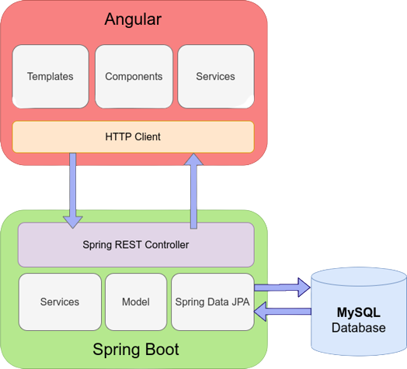
CONNECTION TO DATABASE

Slide 9
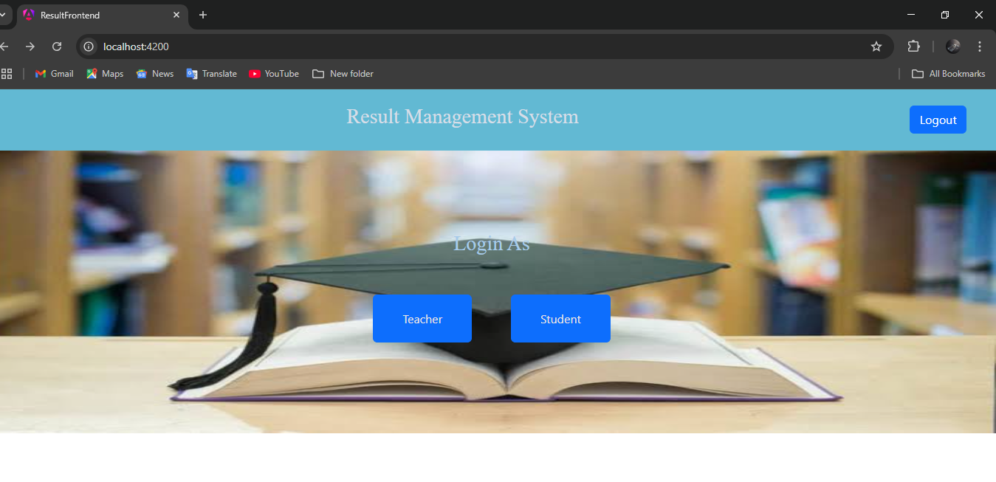
Screen layouts

Slide 10
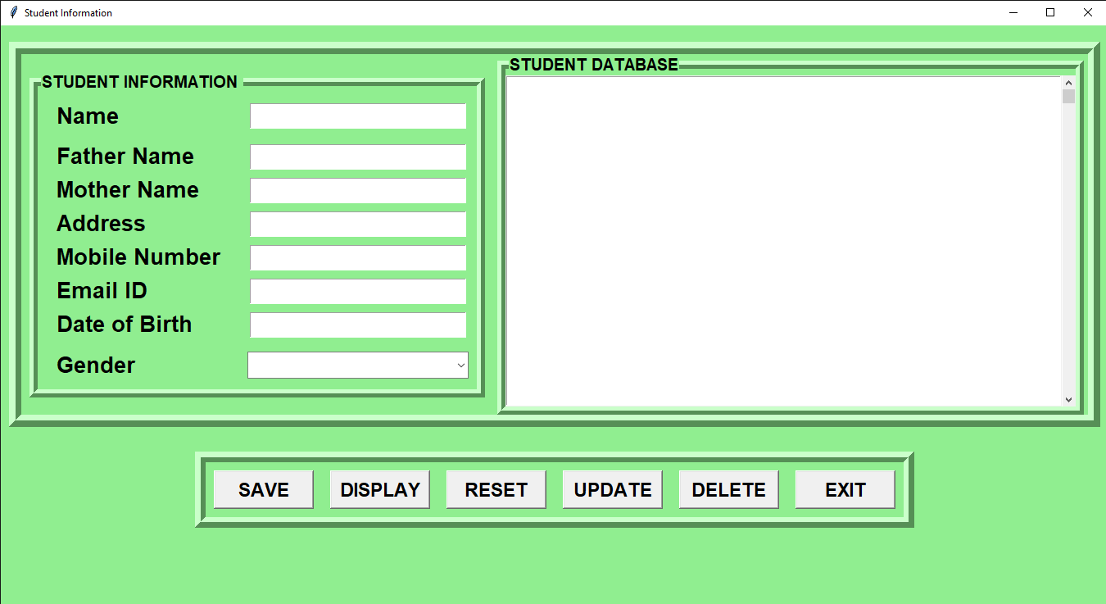
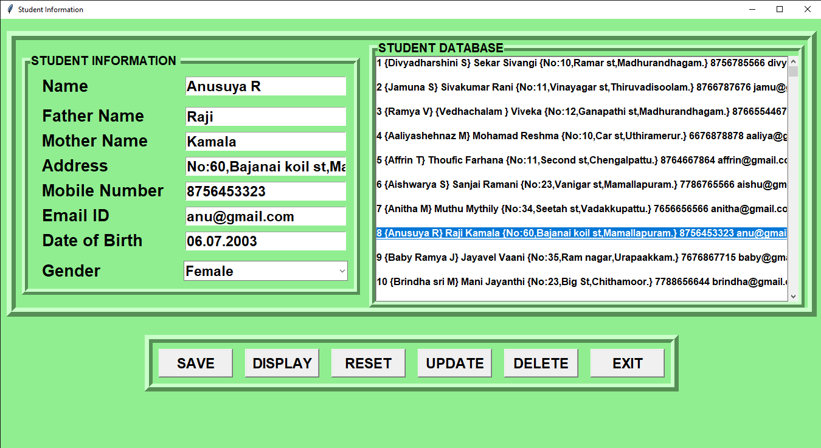
Student profile page/Student profile page data input

Slide 11
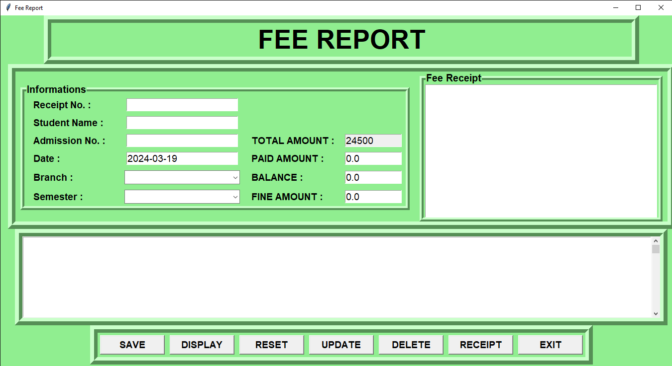
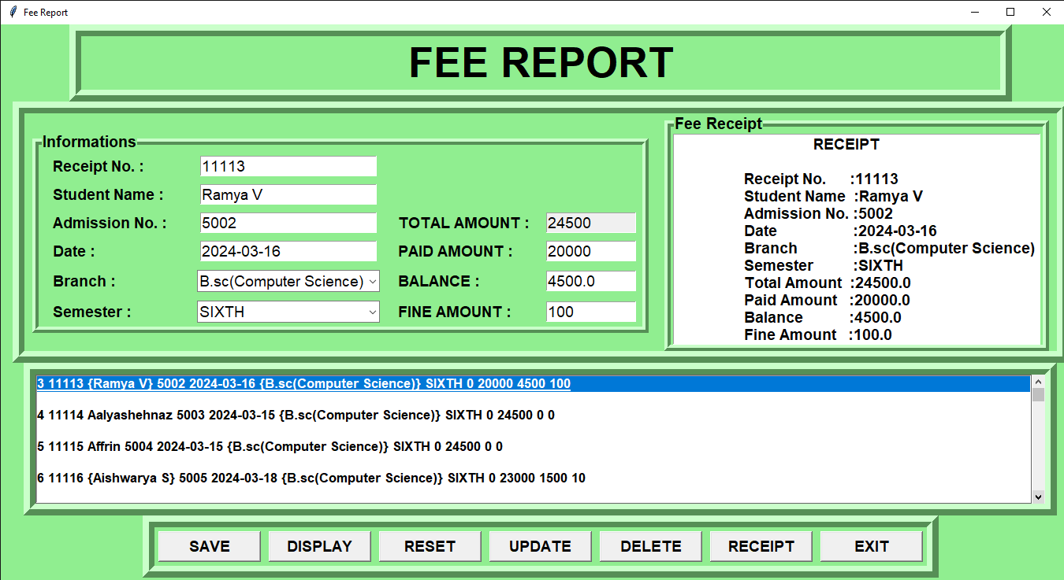
Fees report page/Fees report input page

Slide 12
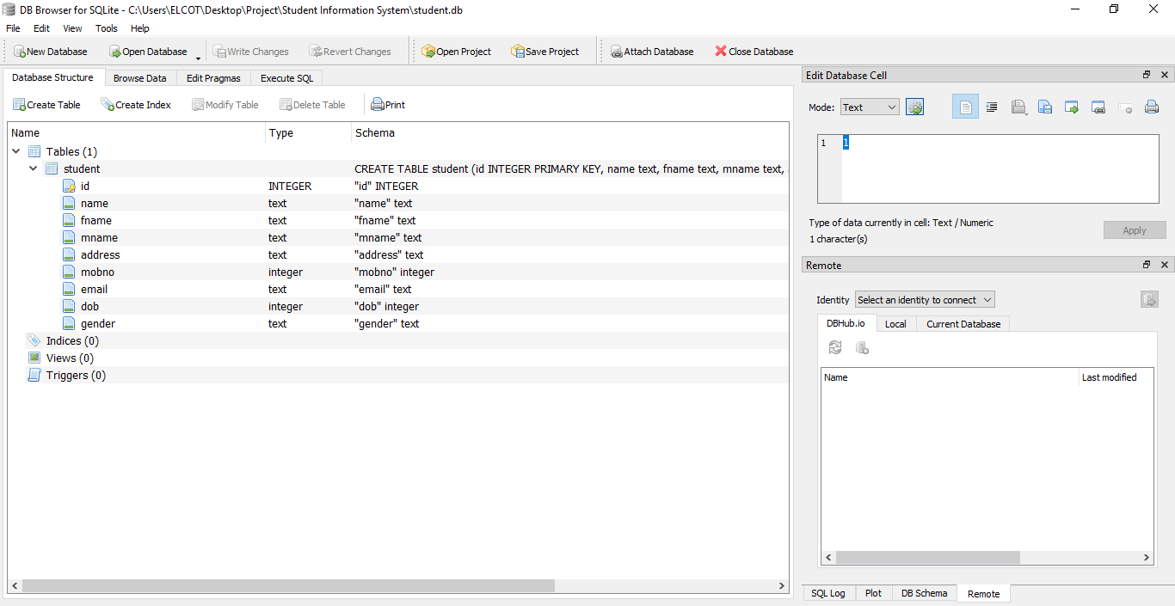
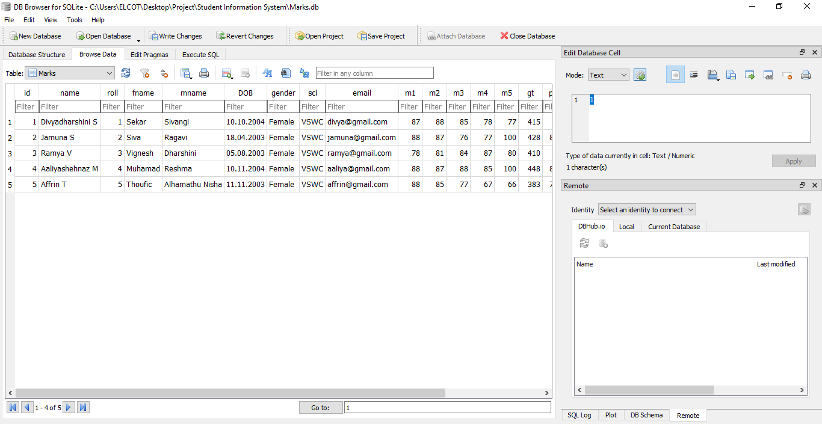
Fees report database structure /fees report database

Slide 13
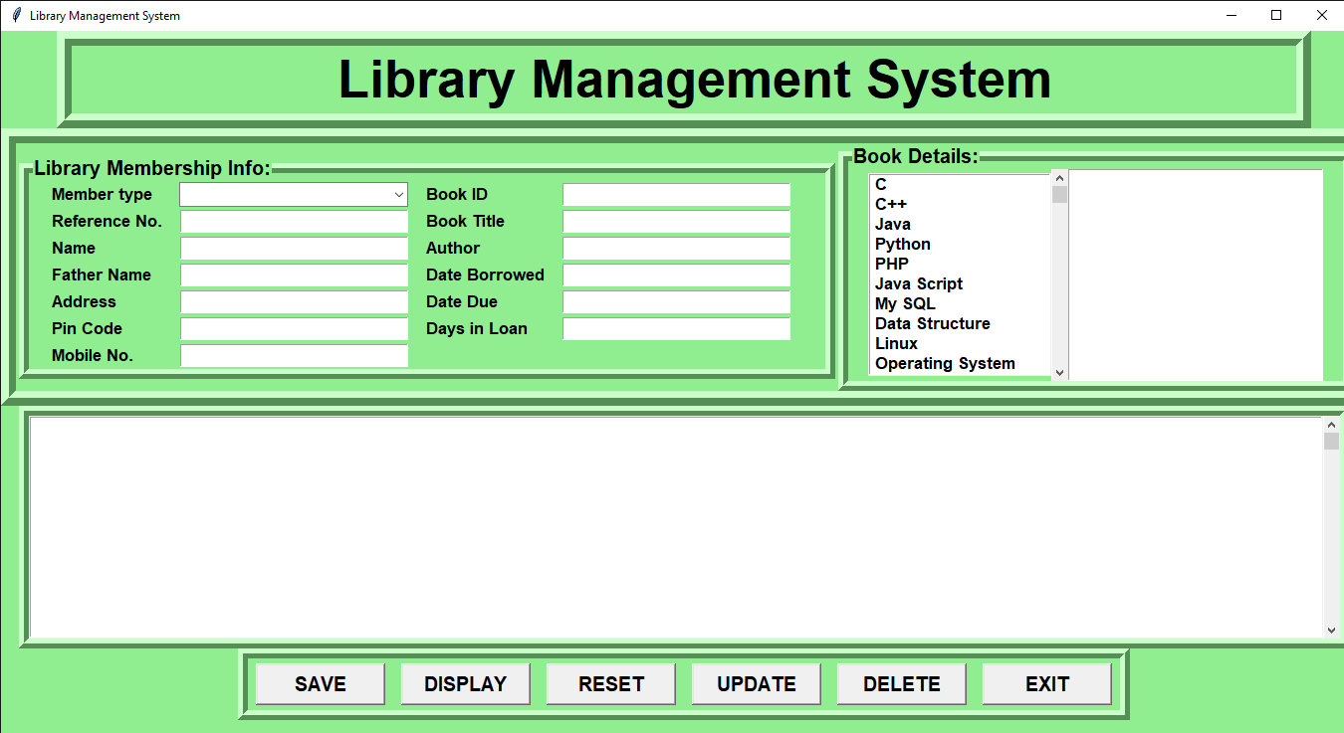
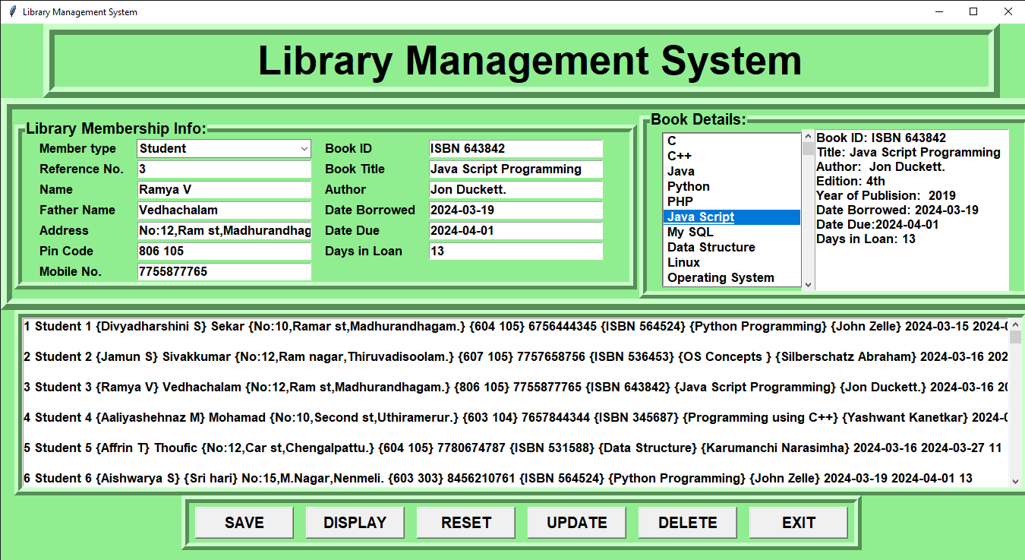
Library system page/Library system data input

Slide 14
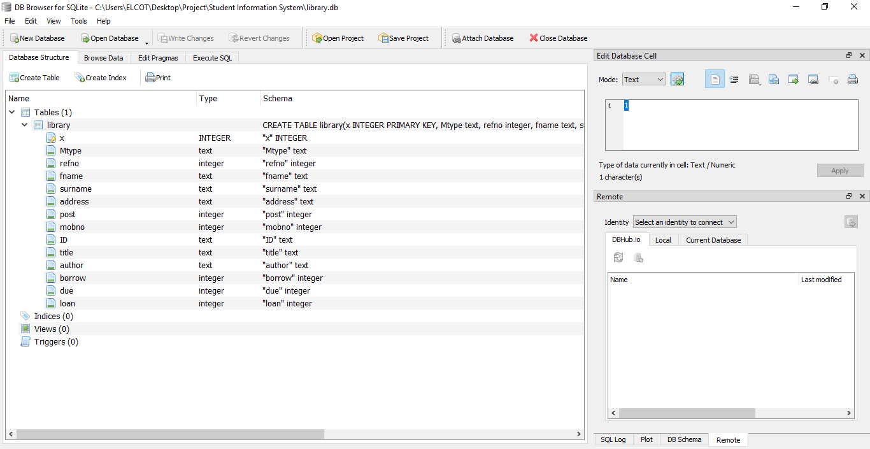
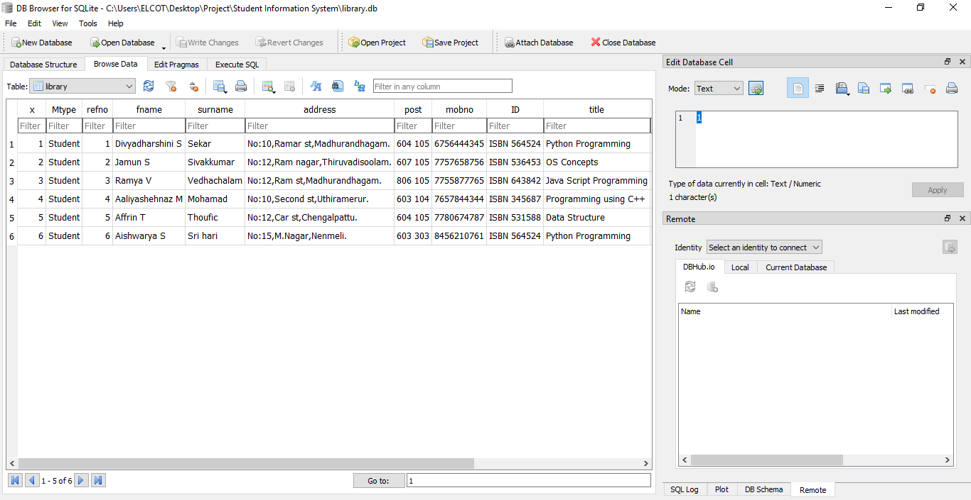
Library system database structure/
Library system database

Slide 15
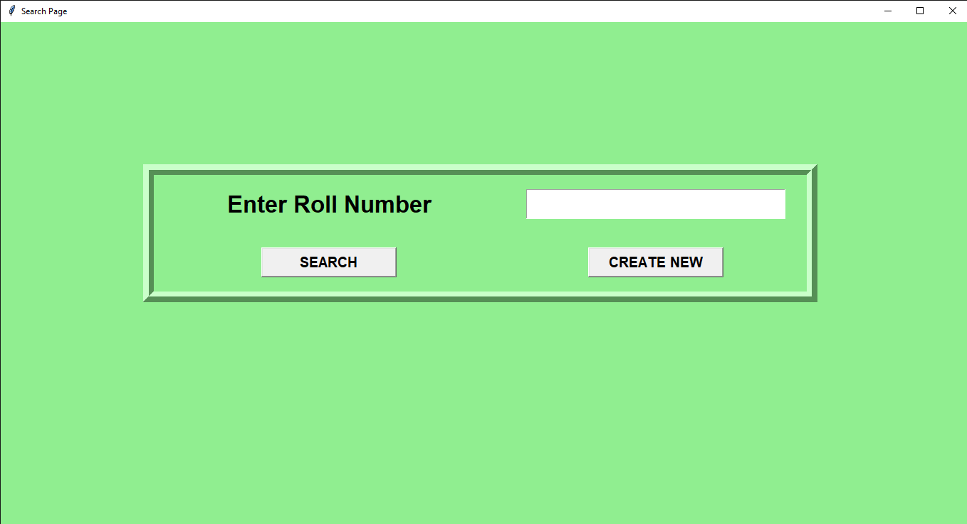
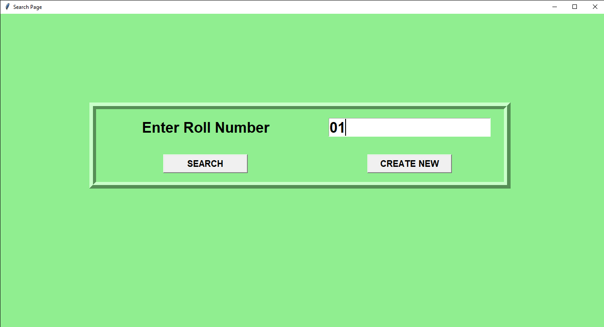
Search page/Search page input

Slide 16
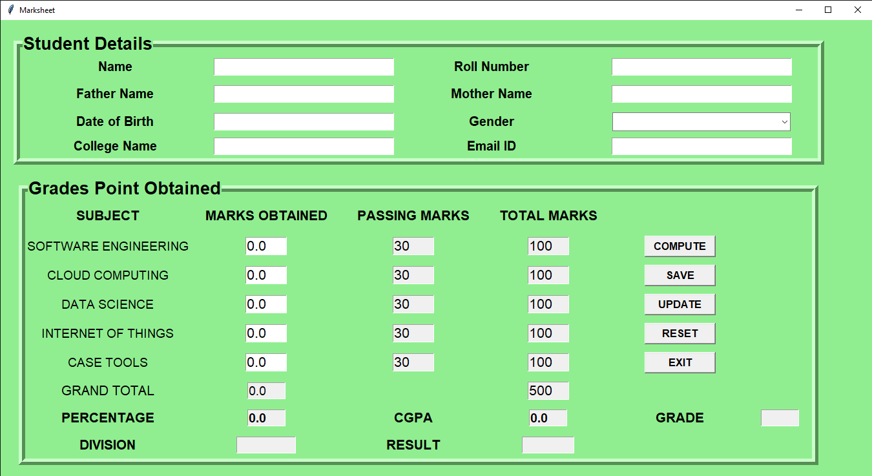
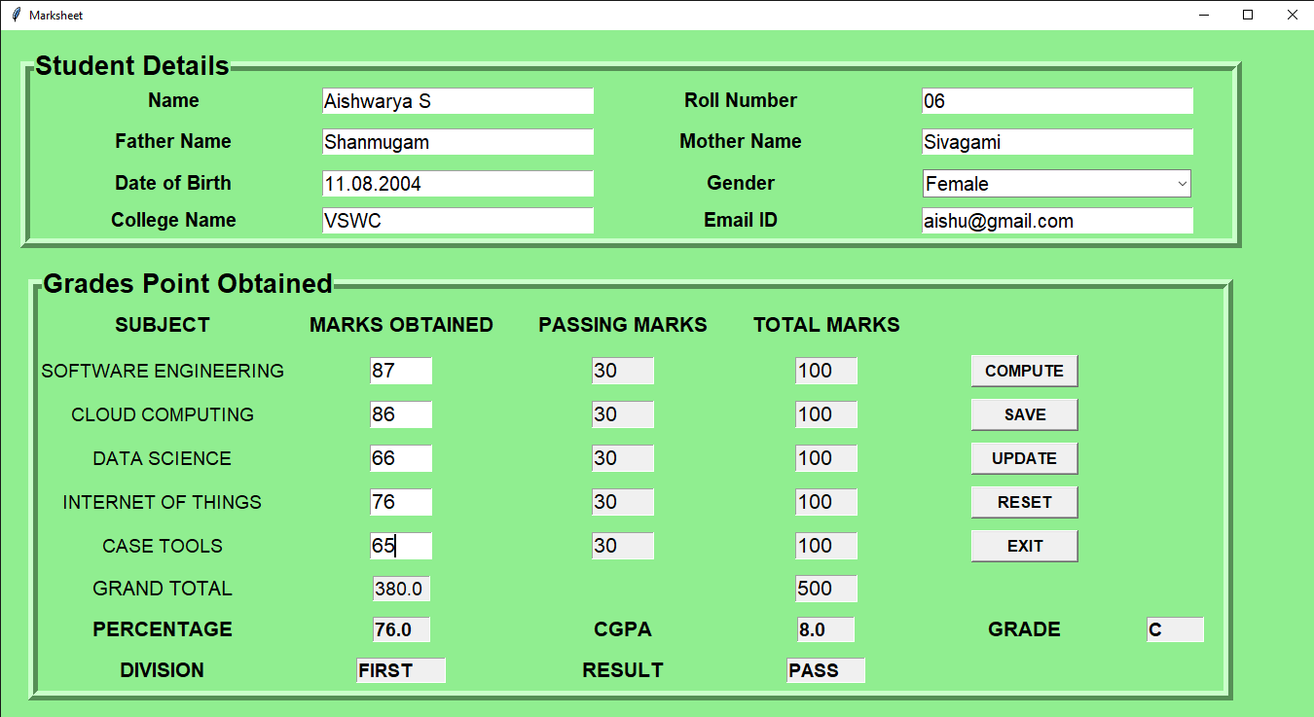
Marksheet page/Marksheet data input page

Slide 17


01
By the use of Admin’s username,password and users’s username password any one can access(student,staff,administration).
FUTURE ENHANCEMENT
The future of result management system lies in the integration of AI enabling predictive analytics personalized learning paths and automated decision making process
02
03
With the increasing reliance on mobile devices ,result management system are poised to become more mobile friendly,providing on-the-go access to information for both administrators and staff

Slide 18
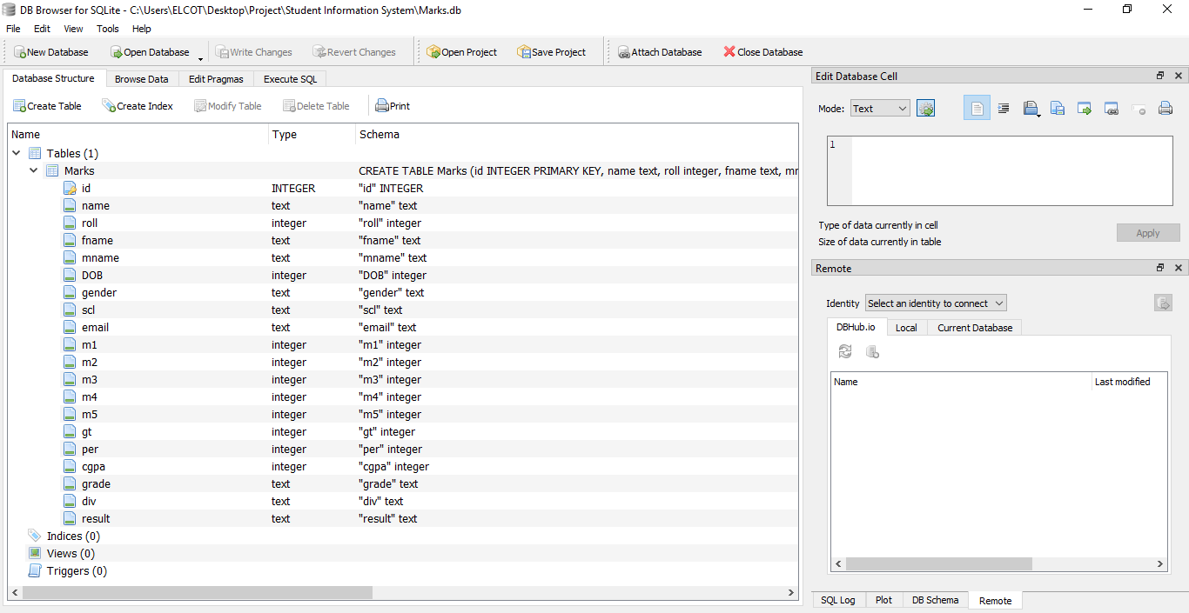
Marksheet database structure/
Marksheet database

Slide 19

CONCLUSION
In conclusion, The Result Management System (RMS) is designed to solve the challenges that understudy face in school with their board records.
The RMS was built with Angular, MYSQL, HTML, CSS, and SPRINGBOOT.
The Result Management System is designed to manage student records, grades, and result generation efficiently.
The system will have separate roles for admins (faculty/staff) and students to handle and view academic results.

Slide 20

THANK
YOU

